Slide 2
Intro To Computer Vision
Ibrahim Hendawi Ibrahim

Slide 3
Agenda
What’s Computer Vision?
Applications of Computer Vision
Computer Vision Challenges
What's Image
What's Color Space
Optical character recognition (OCR)

Slide 4
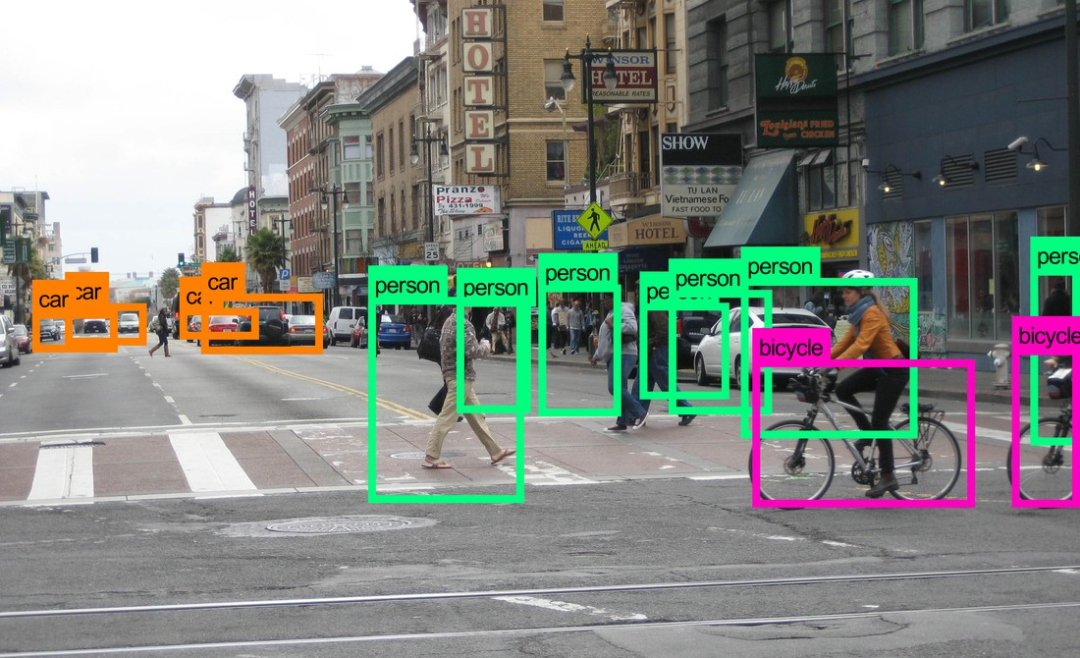
What's Computer Vision​?
Computer vision (CV) is the subcategory of artificial intelligence (AI) that focuses on building and using digital systems to process, analyze and interpret visual data.
The goal of computer vision is to enable computing devices to correctly identify an object or person in a digital image and take appropriate action

Slide 5
Agenda
What’s Computer Vision?
Computer Vision Challenges.
What's Image?
What's Color Space?
Optical character recognition (OCR)
Applications of Computer Vision.

Slide 6
Application of Computer Vision.
Image Classification : categorizing images
Object Detection :
Self-driving cars
Robotics
Automated retail stores
Traffic detection
Smartphone camera apps
Object tracking:
Following robots
surveillance cameras

Slide 7
Application of Computer Vision.
Image Segmentation:
Clustering image pixels belonging to the same object.
Recent applications in self-driving cars and healthcare analysis using image regions.
Image generation.

Slide 8
Agenda
What’s Computer Vision?
Applications of Computer Vision.
What's Image?
What's Color Space?
Optical character recognition (OCR)
Computer Vision Challenges.

Slide 9
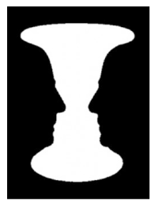
Challenges of Computer Vision
The following are a few important aspects of images that can make the interpretation of images complex.
Illusions : Illusions in an image can be confusing. For example, is this faces facing each other or a vase?

Slide 10
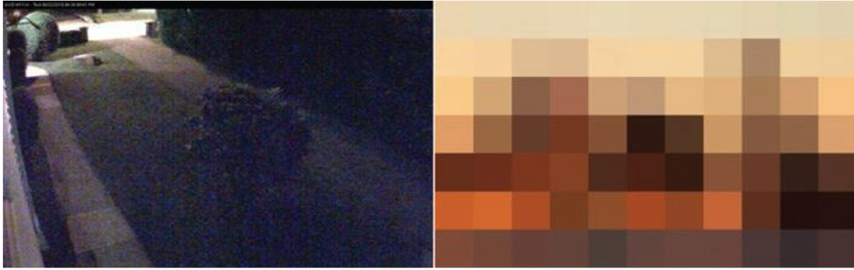
Challenges of Computer Vision
2. Zooming: There can be issues with camera sensors in low or bad
light conditions. The images can get noisy or pixelated when
zooming in.

Slide 11
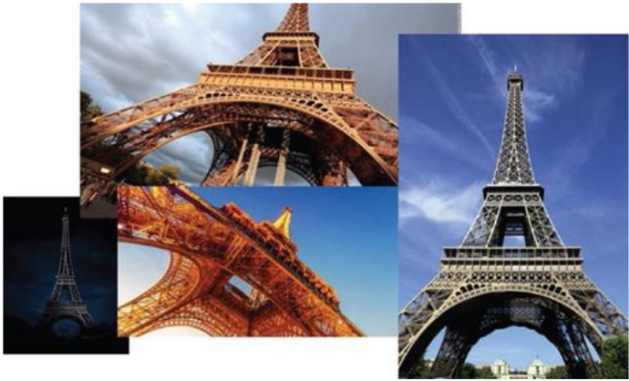
Challenges of Computer Vision
3. Different angles: The same object can look different from different
angles. For example, the figure shows the Eiffel Tower from different
angles.

Slide 12
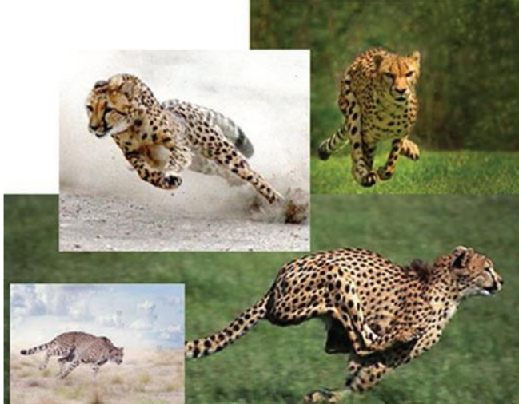
Challenges of Computer Vision
4. In motion: An object in motion can look different during the
movement. For example, the figure shows different images of a
cheetah running.

Slide 13
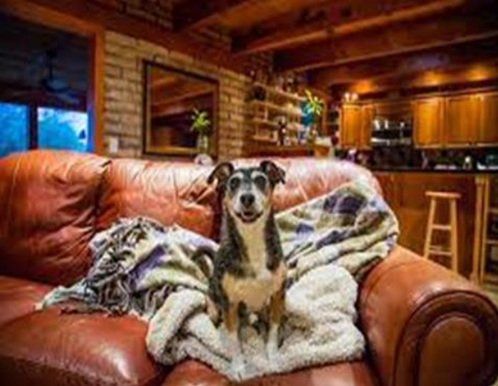
Challenges of Computer Vision
5. Background clutter: There can be background clutter that can
make identifying the object of focus difficult.

Slide 14
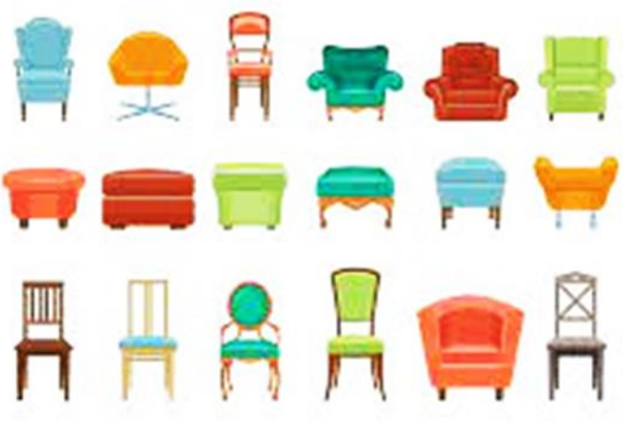
Challenges of Computer Vision
6. Variations: There can be many variations of the same object, such
as different kinds of chairs.

Slide 15
Agenda
What’s Computer Vision?
Applications of Computer Vision.
Challenges of Computer Vision.
What's Color Space?
Optical character recognition (OCR)
What's Image?

Slide 16
What's Image?
It is the core input to computer vision
An image is a two-dimensional matrix with a finite number of rows and columns
The width of an image is represented by the number of columns in the matrix.
The height of the image is represented by the number of rows in the matrix.
An image is composed of multiple pixels, and a pixel is represented by one element in the matrix.
The pixel values can take either a number between 0 and 255 or an RGB representation.
A combination of these values then forms a color.

Slide 17
Agenda
What’s Computer Vision?
Applications of Computer Vision.
Challenges of Computer Vision.
What's Image?
Optical character recognition (OCR)
What's Color Space?

Slide 18



Color Space.
Grayscale
a pixel is represented as a single 8-bit integer that corresponds to the brightness of that pixel
RGB scale
each pixel represented by three different 8-bit integer values that correspond to the red, green, and blue color intensity of that pixel
CMYK scale
four-channel color space is the CMYK color space (representing cyan, magenta, yellow, and key/black).

Slide 19
Agenda
What’s Computer Vision?
Applications of Computer Vision.
Challenges of Computer Vision.
What's Image?
What's Color Space?
Optical character recognition (OCR)

Slide 20
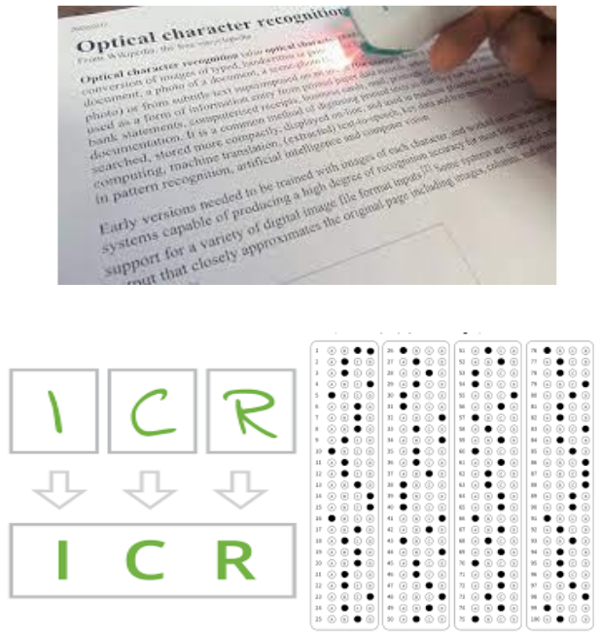
Optical character recognition (OCR)
OCR recognizes scanned images and translates images into text
Reduces the storage needed to store images
OCR deals with machine printed characters
ICR (Intelligent character recognition) deals with handwritten characters
ICR is more complex than OCR
Optical mark recognition (OMR) is similar to OCR and ICR. It is used to compute scores in examinations.

Slide 21
Any Question?

Slide 22
Thanks

